Slide 1

BROWN
WHITE
Thunder
Ambiance

Slide 2
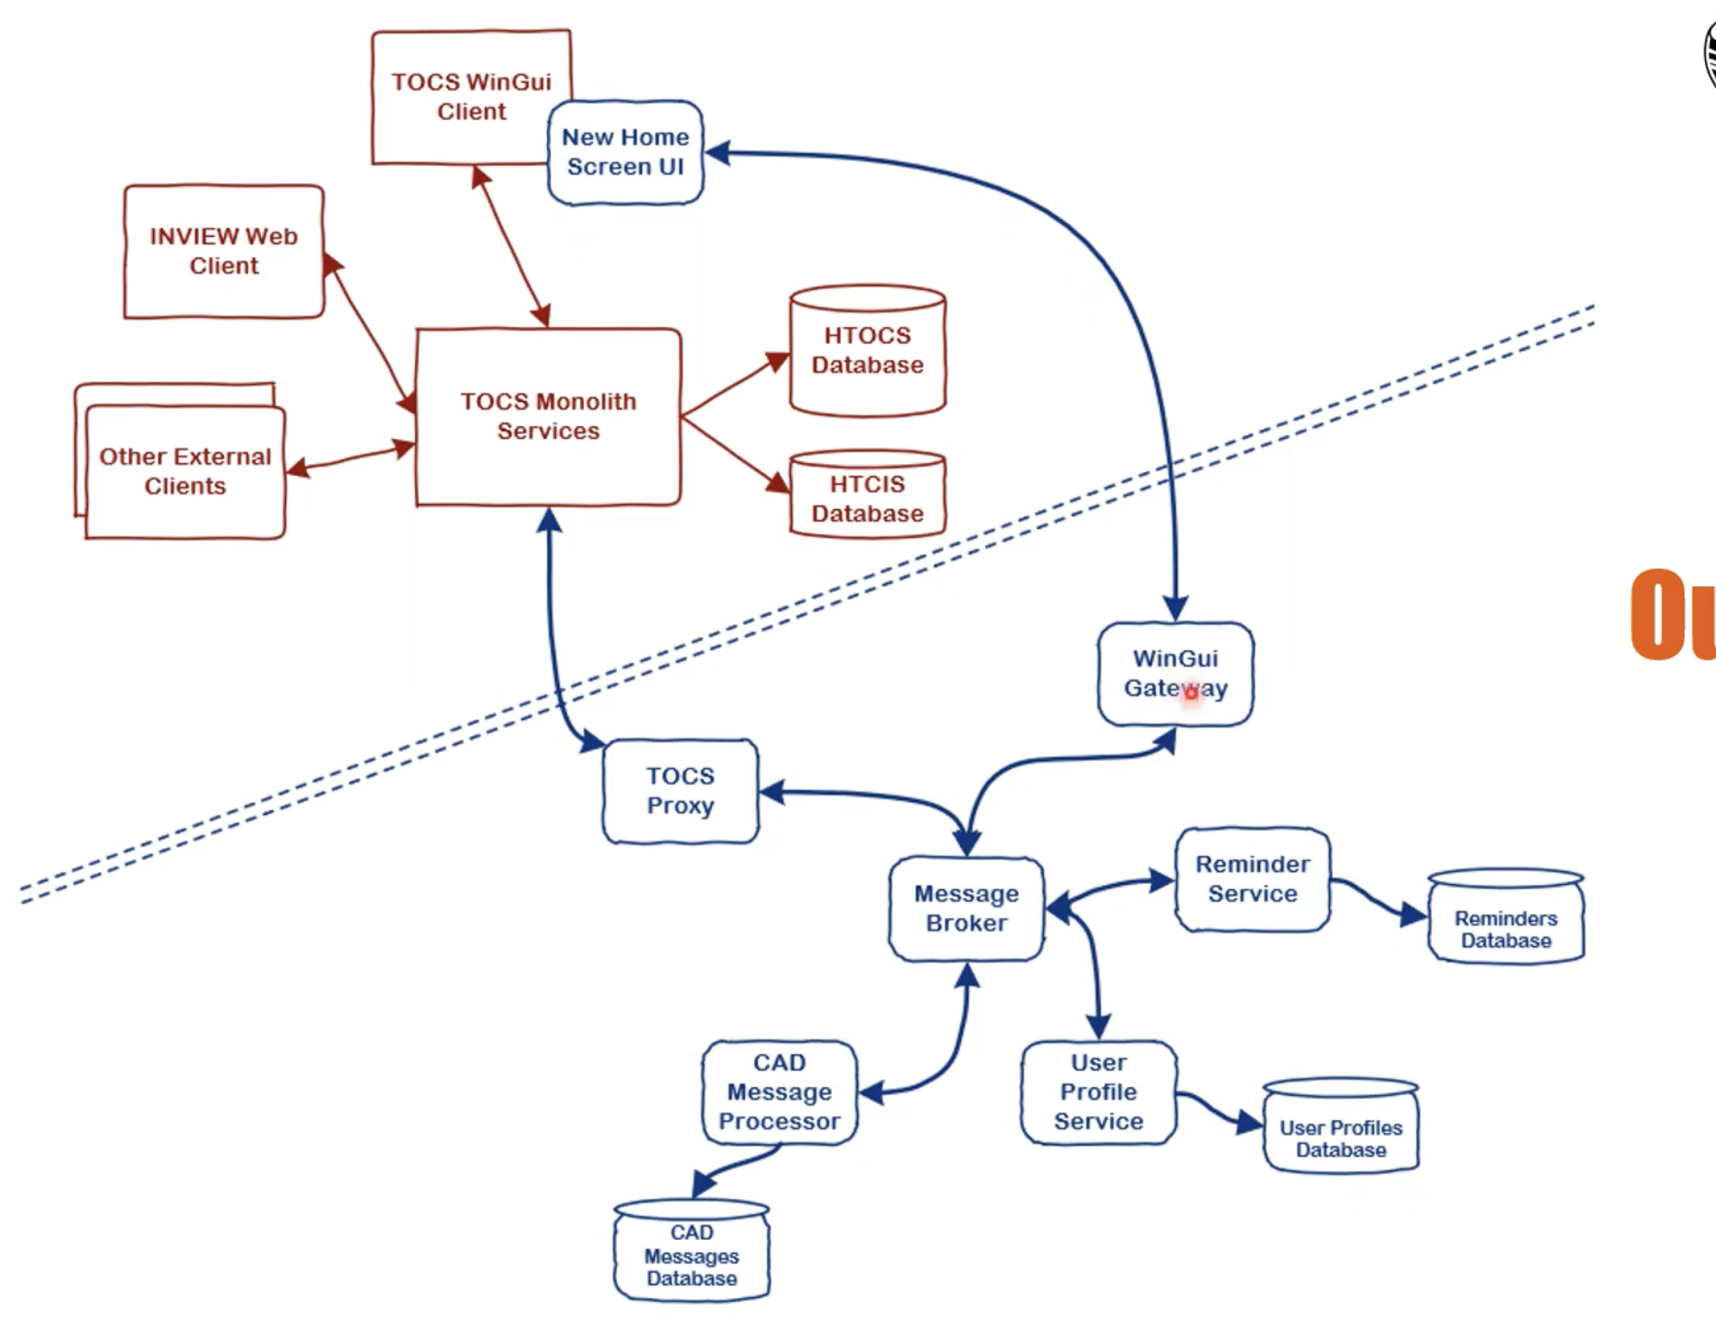









Slide 3


Slide 4
User Login
Page 1
Registration
User Albums
Page 2
Page 3
Create/Edit Journal Entry
View Photo Journal Entry
Page 4
Page 5

Slide 5
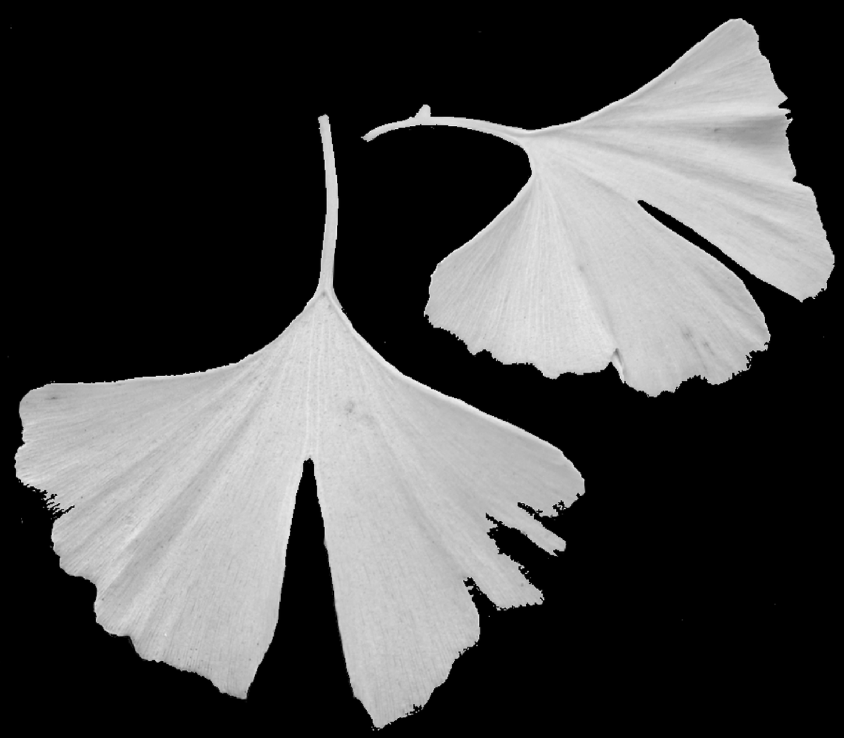

Slide 6
Ideas
Blog with photo upload
Photo storage (albums/timelines), health tracking
Tree sitting
Pop up events
Pest identification
User validation vs list
Image handling (posting to database and retrieval from database)

Slide 7
Tree Timeline Page/Blog
Date optional
Image
(click to enhance)
Text text text text
Comments
Delete
Text text text text
Image
optional
Date optional
Comments
Delete

Slide 8
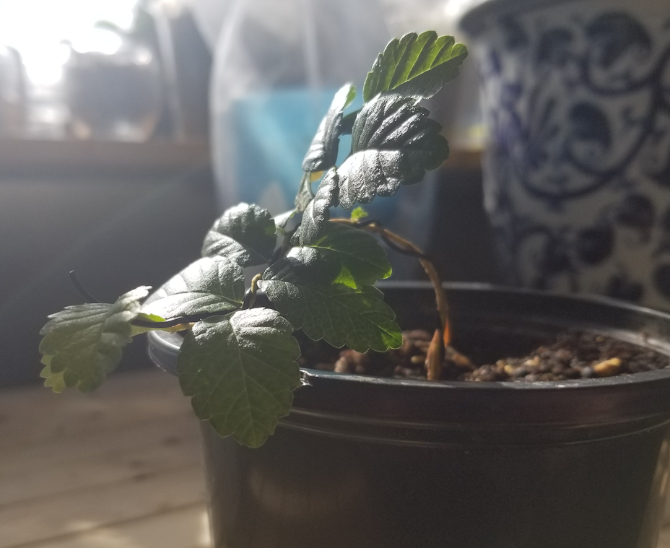
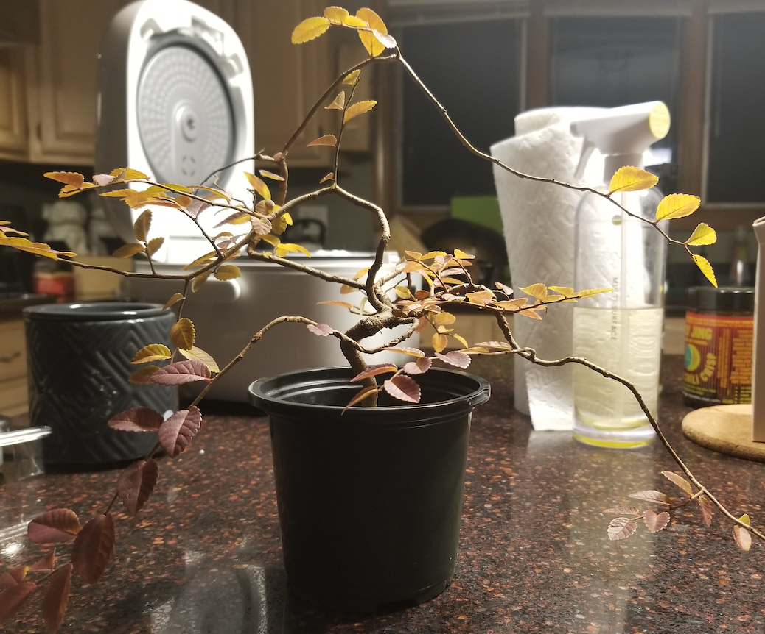
Tree Timeline Page/Blog
wheel
Date optional
Image
(click to enhance)
Text text text text
Comments
Delete
Text text text text
Login
Login validation
photo
Image
optional
Date optional
Blog
Comments
Delete
Edit

Slide 9
Tree Sitting
Date required
Profile Pic?
Looking for tree sitter…
Location (city only)
Dates
Fullfilled?
Comments

Slide 10
Pop Up Event
S | M | T | W | Th | Fr | S
Host: Time: Contact: Remaining Spots Available: Attendees:

Slide 11
Health issue identification- Upload Picture
Tree Species…
Issue 1
-picture
Issue 2
-picture
Issue 3
-picture
Issue 4
-picture
Picture Upload
…

